Slide 1
Computer Vision
Lecture # 2: Filtering
Dr. Shahid Ismail

Slide 2
Spatial Domain vs. Transform Domain
Spatial domain
image plane itself, directly process the intensity values of the image plane
Transform domain
process the transform coefficients, not directly process the intensity values of the image plane

Slide 3
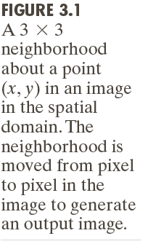
Spatial Domain Process

Slide 4
Some Basic Intensity Transformation Functions

Slide 5
Power-Law (Gamma) Transformations

Slide 6
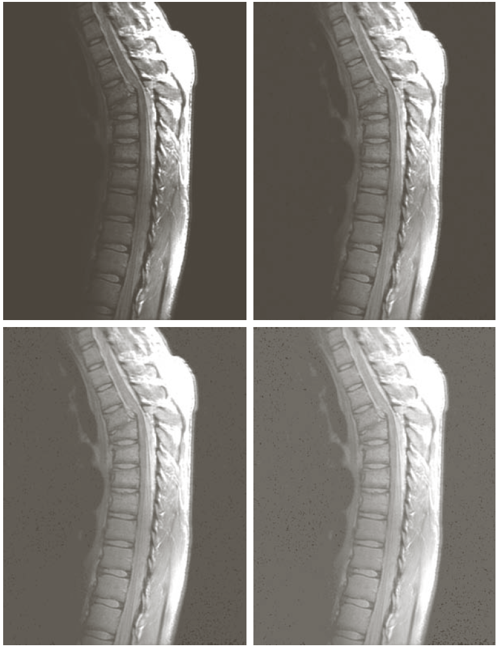
Example: Gamma Transformations

Slide 7
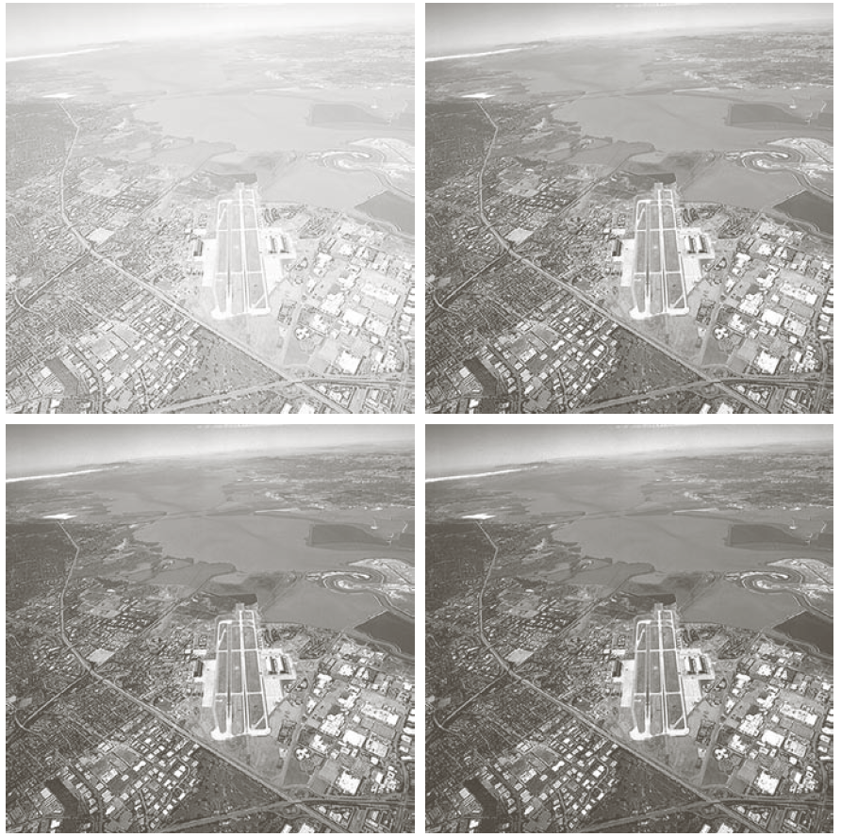
Example: Gamma Transformations

Slide 8
Piecewise-Linear Transformations
Intensity-level Slicing
— Highlighting a specific range of intensities in an image often is of interest.
Contrast Stretching
— Expands the range of intensity levels in an image so that it spans the full intensity range of the recording medium or display device.

Slide 9
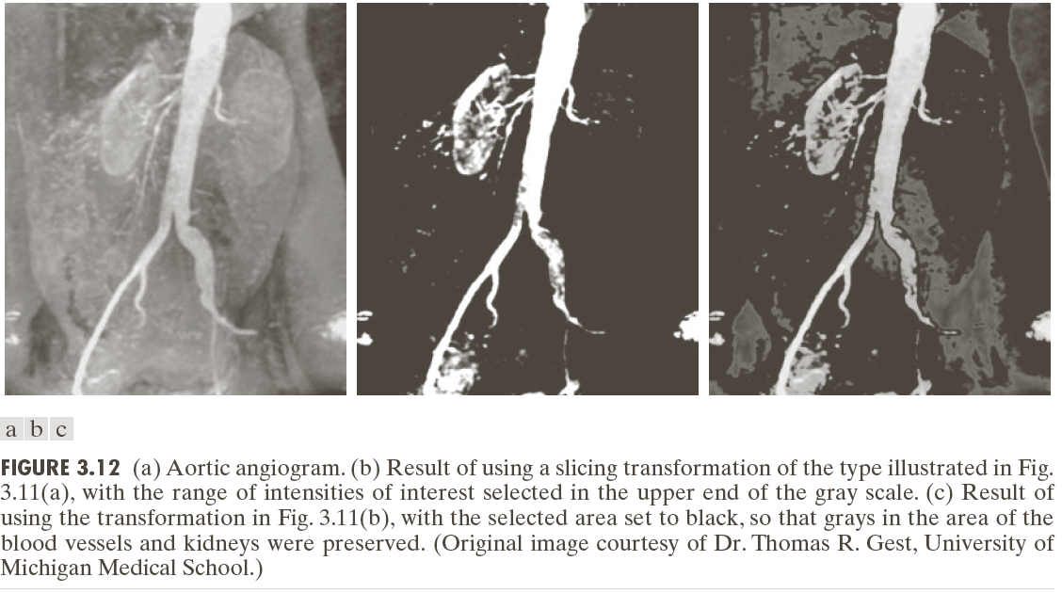
Intensity-level Slicing
Highlight the major blood vessels and study the shape of the flow of the contrast medium (to detect blockages, etc.)
Measuring the actual flow of the contrast medium as a function of time in a series of images

Slide 10
Spatial Filtering
A spatial filter consists of (a) a neighborhood, and (b) a predefined operation
Linear spatial filtering of an image of size MxN with a filter of size mxn is given by the expression

Slide 11
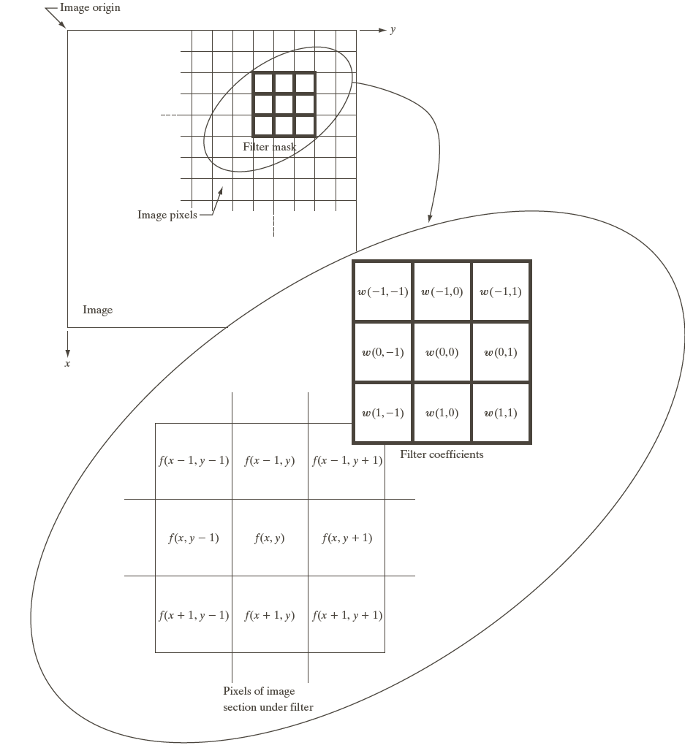
Spatial Filtering

Slide 12
Spatial Correlation

Slide 13
Spatial Convolution

Slide 14
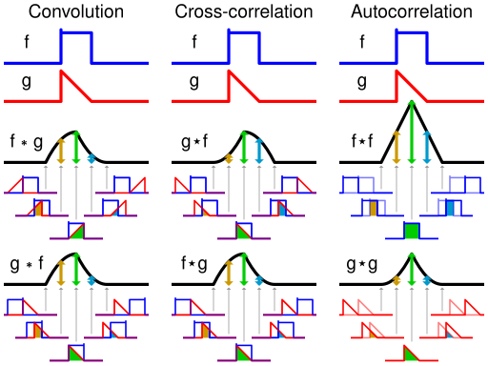
Correlation Vs Convolution
https://en.wikipedia.org/wiki/Cross-correlation

Slide 15
Convolution
https://en.wikipedia.org/wiki/Convolution

Slide 16
2D Convolution
https://en.wikipedia.org/wiki/Convolution

Slide 17
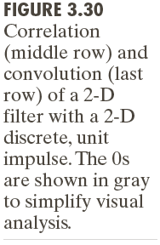

Slide 18
Two Smoothing Averaging Filter Masks

Slide 20
Example: Use of Median Filtering for Noise Reduction

Slide 21
Sharpening Spatial Filters
Foundation
Laplacian Operator
Derivatives /Gradient

Slide 22
Sharpening Spatial Filters: Foundation
The first-order derivative of a one-dimensional function f(x) is the difference
The second-order derivative of f(x) as the difference

Slide 23
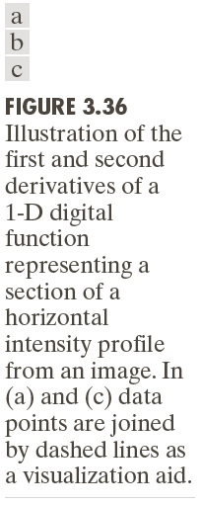

Slide 24
Sharpening Spatial Filters: Laplace Operator
The second-order isotropic derivative operator is the Laplacian for a function (image) f(x,y)

Slide 25
Image Sharpening based on First-Order Derivatives
z₁ | z₂ | z₃
z₄ | z₅ | z₆
z₇ | z₈ | z₉

Slide 26
Image Sharpening based on First-Order Derivatives
z₁ | z₂ | z₃
z₄ | z₅ | z₆
z₇ | z₈ | z₉

Slide 27
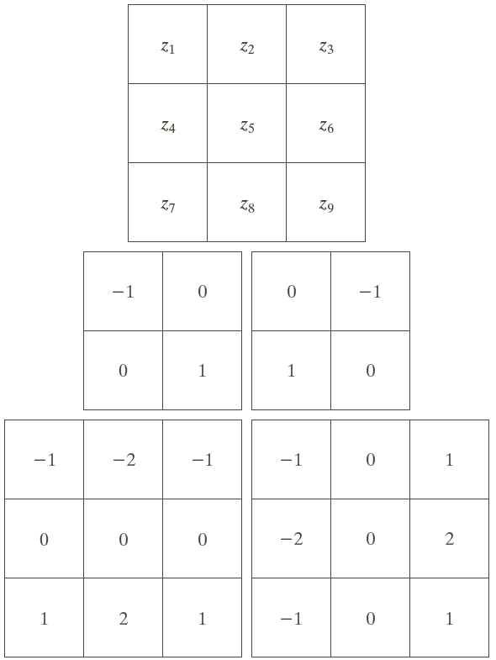
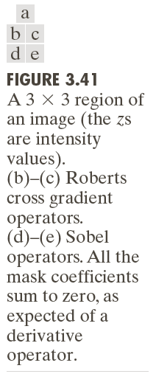
Image Sharpening based on First-Order Derivatives

